Slide 1
Introduction to ROS
Instructor: Lee Yueyu

Slide 2
Agenda
Robot Operating System (ROS) [2 hours]
Filesystem
Computation graphs (nodes, topics, messages, services, etc)
Turtlebot tutorial

Slide 3

What is Robot Operating System (ROS)?
Open-source software development kit for robotics applications
Widely-used by robotics institutions worldwide
Provides a framework for collaboration
Enables reusing of various packages
(e.g. sensors, algorithms, simulator, etc)
Notes:
Open source implies free and readily available.
Widely proven and used by education and industry. Alot of pre-existing packages available for adoption. Highly maintained and supported.
The “brains” of the robot

Slide 4

Which OS supports ROS?
Notes:
https://codinghero.ai/how-operating-system-works-5-basic-functions-explained-to-kids/

Slide 5

What is Linux?
Open-source unix-like operating system (OS)
(A free alternative to Windows / MacOS)
Developer-friendly OS with ready access to development tools (e.g. apt-get, ssh, etc)
Only OS that fully supports ROS

Slide 6
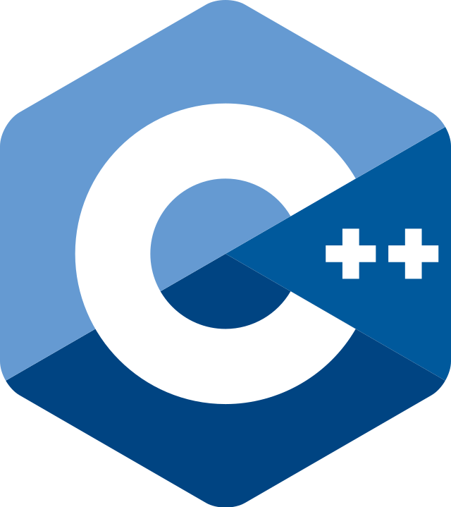


Roadmap to understanding ROS
Programming in Linux
C++ Programming
CMake
Robot Operating System
Robot Software
Linux command line scripting

Slide 7
What is C/C++ programming?
Efficient and stable compiled programming language
Widely-utilized in embedded systems

Slide 8
C++ Programming – Fundamentals
Preprocessor directive (#) – Commands preprocessing before compilation
Keywords – Pre-defined words with special meanings (e.g. bool, int, double)
Variables – Named data-storage entity
Functions – Collection of statements to perform a specific task

Slide 9
C++ Programming – Exercise
Try it yourself!
https://www.programiz.com/cpp-programming/online-compiler/

Slide 10
Example 1 - Hello world!
Import all code from iostream file before compilation
iostream contains all the standard input/output functions, such as std::cout statements
#include <iostream>
int main() {
std::cout << “Hello world!”;
return 0;
}
returnType functionName( )
Function statements to perform the desired objective
Function returns the same type declared in returnType
Note: The function “main” is the starting point of every C++ code by default.

Slide 11
Example 2 - addTwoIntegers
int addTwoIntegers(int x , int y)
{
int result = x + y;
return result;
}
returnType functionName (argType1 argName1, argType2 argName2)
Function statements to perform the desired objective
Function must return the same type declared in returnType

Slide 12
Example 3 – Putting both together
#include <iostream>
int addTwoIntegers(int x , int y) {
int result = x + y;
return result;
}
int main() {
int sum = addTwoIntegers(2, 3);
std::cout << “Sum is ” << sum << std::endl;
return 0;
}
Any auxiliary functions used should be declared/defined before the main function
Output: Sum is 5

Slide 13
C++ Programming – Arrays
int studentScores[5]; // Declares an array of 5 integers. Note: random initialization
studentScores[0] = 98;
studentScores[1] = 72;
studentScores[2] = 94;
studentScores[3] = 88;
studentScores[4] = 79;
[0]
[1]
[2]
[3]
[4]
studentScores
98
72
94
88
79
Note: C++, like most programming languages, starts index from 0
Notes:
Declaration is telling the compiler that the array exists & to allocate memory for it. Initialization means to put a value initially.

Slide 14
C++ Programming – if-else conditions
if (numStudents == 50){
doAction1();
}
else {
doAction2();
}
Notes:
Use number of WOS students as an example. isCourseGood?

Slide 15
C++ Programming – for loops
int numIterations = 5;
for (int i = 0; i < numIterations; i++){
doAction();
}

Slide 16
C++ Programming – while loops
int i = 0;
while (i < 5) {
doAction();
i = i + 1;
}
Condition to remain in loop. Be careful not to make an infinite loop!

Slide 17
C++ Programming – continue / break
int numIterations = 5;
for (int i = 0; i < numIterations; i++){
if (i == 1) continue;
if (i == 3) break;
doAction();
}

Slide 18
C++ Programming – Scope
int outerScope = 5;
if (true) {
int innerScope = 10;
outerScope = 11; }
std::cout << outerScope << std::endl; // 11
>> Variable “innerScope” does not exist!

Slide 19
C++ Programming – Pass by reference
#include <stdio.h>
void incrementCopy(int x) { // Pass by copy
x = x + 5;
}
void incrementReference(int& x) { // Pass by reference
x = x + 5;
}
int main() {
int y = 1;
incrementCopy(y);
printf(“output = %d”, y); // output = 1
incrementReference(y);
printf(“output = %d”, y); // output = 6
}
Creates a copy of the argument.
Modifies the copy within the function
Points to the memory of the argument. Modifies the argument directly.
Notes:
So far, we have always seen a .o file in the compiler. What’s that?

Slide 20
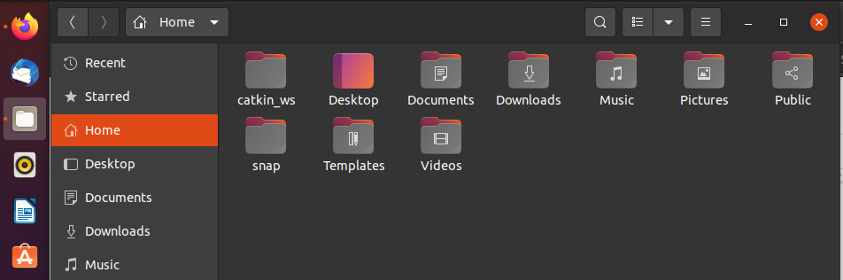
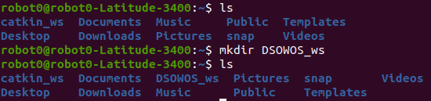
What is Command Line Scripting?
Graphic User Interface (GUI)
Command Line Interface (CLI)
Terminal: Ctrl + Alt + T
It takes time getting used to it, but CLI is more efficient for programming!

Slide 21
Command Line Cheatsheet (Non-comprehensive!)
Command | Description
< tab key > | Autofill commands
< up arrow key > | Previous history commands
ls | List files in current working directory
pwd | Check current working directory
cd directory | Change the current working directory
cd .. | Change the current working directory up one level
cd ~ | Change the current working directory to user’s home directory
mkdir directory-name | Make a new sub-directory
echo string >> file | (1) Echo display string as stdout on terminal. (2) >> redirects stdout to file
< cmd1> | < cmd2> | Pipe output from cmd1 as input to cmd2
export | To change an environment variable
source | Execute (run) a bash script
NOTE: BE CAREFUL OF DANGEROUS COMMANDS!

Slide 22
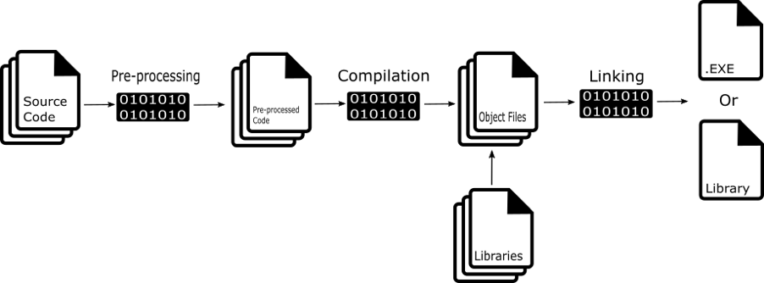
C++ Compilation
High-level source code (if-else, for-loops, etc)
Assembly language (binary)
intermediaries
Notes:
https://betterprogramming.pub/learn-how-to-compile-a-c-program-382c4c690bdc
Pre-processing: Include statements, define statements, header files etc
Compilation: convert into intermediaries object files. Linking will link all the object files together (find the various functions defined)

Slide 23
What is Cross-Platform Make (CMake)?
Open-source tool to build and compile C/C++ scripts (alternative to IDEs)
Out-of-source build structure keeps source code and binaries cleanly separated

Slide 24
CMake Example 1 – Hello World
Required functions:
add_executable(greetings main.cpp)
Name of .exe file
Source files needed for this executable. You can specify multiple files

Slide 25
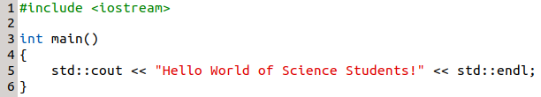
CMake Example 1 – Hello World
[~/DSOWOS_ws/HelloWorld]$ mkdir src
[~/DSOWOS_ws/HelloWorld]$ cd src/
[~/DSOWOS_ws/HelloWorld/src]$ echo "" >> main.cpp
[~/DSOWOS_ws/HelloWorld/src]$ echo "" >> CMakeLists.txt
[~/DSOWOS_ws/HelloWorld/src]$ gedit main.cpp
[~/DSOWOS_ws/HelloWorld/src]$ gedit CMakeLists.txt
[~/DSOWOS_ws/HelloWorld/src]$ cd ..
[~/DSOWOS_ws/HelloWorld]$ mkdir build
[~/DSOWOS_ws/HelloWorld]$ cd build
[~/DSOWOS_ws/HelloWorld/build]$ cmake ../src -- Configuring done
-- Generating done
-- Build files have been written to: ~/DSOWOS_ws/HelloWorld/build
[~/DSOWOS_ws/HelloWorld/build]$ cmake --build . Scanning dependencies of target greetings
[ 50%] Building CXX object CMakeFiles/greetings.dir/main.cpp.o
[100%] Linking CXX executable greetings
[100%] Built target greetings
[~/DSOWOS_ws/HelloWorld/build]$ ./greetings Hello World of Science Students!
Points where cmake should search for source files. Builds binaries into cwd
Build (compile and link) all files into current directory
./ to execute the .exe file named “greetings”

Slide 26

CMake – Workspaces
src
build
All source code
CMakeLists.txt
Intermediary obj files
Executable/library

Slide 27
CMake Example 2 - CalculateAndPrint
Problem Statement:
Let’s make a mini ‘calculator’ which imports a function from a custom library (named ‘printer’)
Directory Structure:
CalculateAndPrint
src
> CMakeLists.txt
> calculator
>> calculator.cpp
>> CMakeLists.txt
> printer
>> printer.cpp
>> printer.h
>> CMakeLists.txt

Slide 28
CMake Example 2 - Printer Library
add_library(printerlib printer.cpp printer.h)
Name of library
Source files needed for this library. You can specify multiple files
target_include_directories(printerlib PUBLIC .)
Specifies the directories to find the header files required
Name of library
External projects can also ‘see’ the header paths
Path to header. “.” means same directory as CMakeLists.txt

Slide 29
CMake Example 2 – Calculator executable
add_executable(calculator calculator.cpp)
target_link_libraries(calculator printerlib)
Specifies the libraries that the target depend on
Name of executable that relies on …
List of libraries that ‘calculator’ needs

Slide 30
CMake Example 2 – Putting all together
Directory Structure:
CalculateAndPrint
src
> CMakeLists.txt
> calculator
>> calculator.cpp
>> CMakeLists.txt
> printer
>> printer.cpp
>> printer.h
>> CMakeLists.txt
add_subdirectory(printer)
add_subdirectory(calculator)

Slide 31
C++ Programming with CMake – Exercise
Create a simple game of in-between
#include <iostream>
#include <stdlib.h> /* srand, rand */
#include <time.h> /* time */
int main(){
srand(time(NULL)); // Initialize random seed
std::cout << "Welcome to the Between game" << std::endl;
int ans = rand() % 100 + 1; // range from 1 -- 100
// Add variables here
while ( XXXX ) {
// Define game logic here!
}
}

Slide 32
Agenda
1) Programming in Linux [1.5 hours]
C++ programming
Command line scripting
Cross-platform make (CMake)
---- Break [30 mins] ----
2) Robot Operating System (ROS) [2 hours]
Filesystem
Computation graphs (nodes, topics, messages, services, etc)
Turtlebot tutorial

Slide 33
Roadmap to understanding ROS
C++ Programming
CMake
Robot Operating System
Robot Software
Linux command line scripting

Slide 34
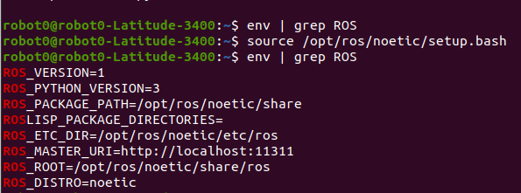
ROS – Environment Set-up
Find the word ROS in ‘env’
Bash terminal needs to know that ROS variables and its commands exists.
Either command “source /opt/ros/noetic/setup.bash” everytime
Or modify ~/.bashrc file directly! Why? ~/.bashrc file is always ran when terminal is open! How? echo “source /opt/ros/noetic/setup.bash” >> ~/.bashrc

Slide 35
ROS – Environment Set-up
To initialize a preliminary workspace:
$ mkdir -p ~/catkin_ws/src
$ cd ~/catkin_ws/
$ catkin_make
Similarly, to import directory packages, echo “source devel/setup.bash” >> ~/.bashrc
-p allows recursive directory creation

Slide 36
ROS – Catkin Workspaces
src
build
devel
All ‘packages’
Intermediary obj files
Executable/library

Slide 37
ROS – File System Level
catkin_ws
> src
>> Package A
>>> src
>>> include (optional)
>>> msg / srv (optional)
>>> CMakeLists.txt
>>> package.xml
>> Package B
>>> src
>>> include (optional)
>>> CMakeLists.txt
>>> package.xml
>> CMakeLists.txt
> build
> devel
Each package can have multiple nodes

Slide 38
ROS Conceptual Overview
Master
Topic 1
Node 1
Topic 2
Node 2
Service 1
Parameter Server
rosmsg
rossrv

Slide 39
ROS – Useful Commands
Command | Description
rospack | Utilities for ROS all packages
roscore | Initialize ROS Master, Parameter Server and logging node
rostopic | Utilities for active ROS topics
rosservice | Utilities for active ROS services
rosparam | Utilities for active ROS parameters
rosmsg | Utilities for all ROS messages
rossrv | Utilities for all ROS services
rosrun | Run a node
roslaunch | Run a launch script

Slide 40
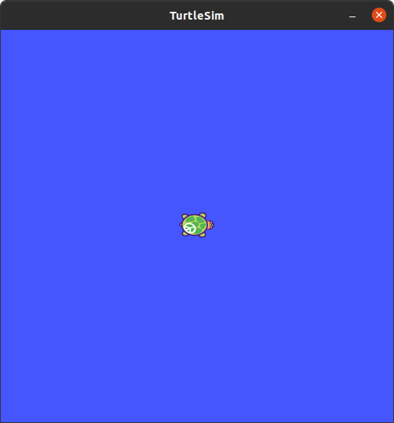
Turtlebot Demonstrator
Let’s try to figure out ROS with a cute demonstrator!
Open 2 terminals and key in the following:
Terminal 1 $ roscore
Terminal 2 $ rosrun turtlesim turtlesim_node
The screen on the right should appear! Note: Everyone’s turtle is random :)
Package name
Node name

Slide 41

ROS Topics
A topic is akin to a ‘conversation space’
What topics are available?
$ rostopic list
/rosout
/rosout_agg
/turtle1/cmd_vel
/turtle1/color_sensor
/turtle1/pose
Is there a better way to visualize these?!
Notes:
Rosout is the console log for ROS. Generally dont need to care.

Slide 42
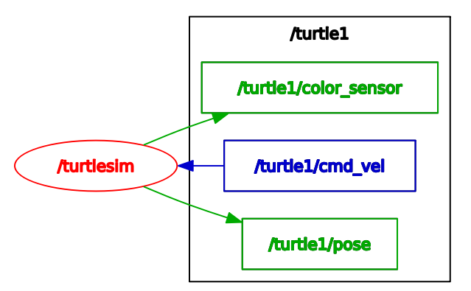
Displaying ROS connections with rqt_graph
rqt_graph is a useful ROS package that can be used to display ROS computation graphs
$ rosrun rqt_graph rqt_graph
Legend:
Ovals – Nodes
Rectangles – Topics
Larger rectangle – Namespace group

Slide 43
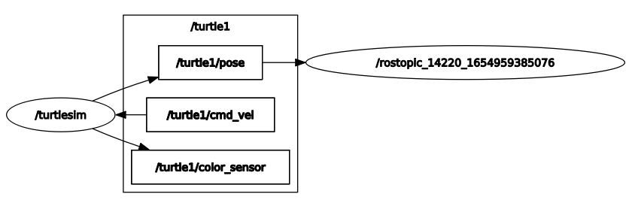
ROS Topics – Echo
Let’s try to ‘listen’ into a topic, /turtle1/pose:
$ rostopic echo /turtle1/pose
… x: 5.544444561004639
y: 5.544444561004639
theta: 0.0
linear_velocity: 0.0
angular_velocity: 0.0

Slide 44
ROS Topics – Echo
$ rostopic echo /turtle1/cmd_vel
< no available data >
Why? Because we have no input to cmd_vel yet!

Slide 45
ROS Topics – Understanding messages
Let’s give the turtlebot a cmd_vel.. But what data structure (i.e. message) to send?
$ rostopic type /turtle1/cmd_vel
geometry_msgs/Twist
$ rosmsg show geometry_msgs/Twist
geometry_msgs/Vector3 linear
float64 x
float64 y
float64 z
geometry_msgs/Vector3 angular
float64 x
float64 y
float64 z
rostopic type displays the type of message used
rosmsg show displays the data structure of the input

Slide 46
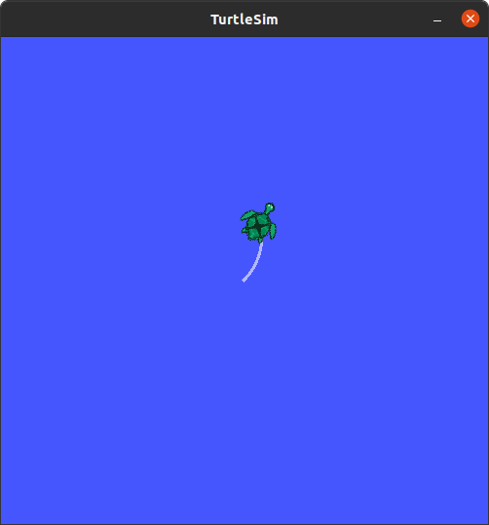
ROS Topics – Pub
We now know what turtlebot is expecting to receive via ‘cmd_vel’
Let’s publish some data into it directly!
$ rostopic pub /turtle1/cmd_vel geometry_msgs/Twist "linear:
x: 1.0
y: 1.0
z: 0.0
angular:
x: 0.0
y: 0.0
z: 1.0"
>> publishing and latching message. Press ctrl-C to terminate
Alternatively,
$ rostopic pub /turtle1/cmd_vel geometry_msgs/Twist ‘[1.0, 1.0, 0.0]’ ‘[0.0, 0.0, 1.0]’
>> publishing and latching message. Press ctrl-C to terminate

Slide 47
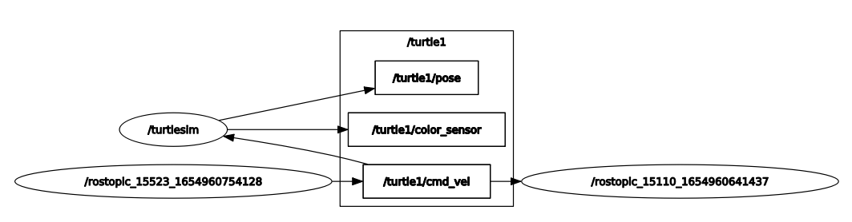
ROS Topics – Pub
Check your rostopic echo /turtle1/cmd_vel. You should have some outputs now!
How does the connection look like now?

Slide 48

ROS Topics – Pub
Is there a way to recursively publish to a topic? Yes! With (optional) arguments!
You should see your turtle moving continuously now!
… But manually keying commands seem tedious :(
$ rostopic pub /turtle1/cmd_vel geometry_msgs/Twist -r 1 ‘[2.0, 0.0, 0.0]’ ‘[0.0, 0.0, -1.8]’

Slide 49
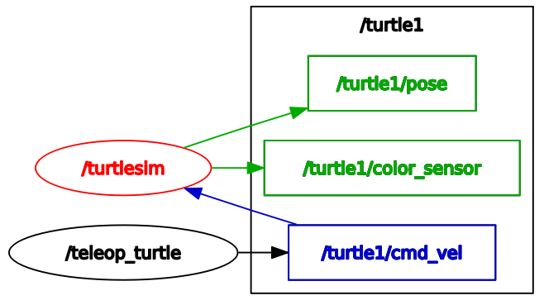
ROS Topics – Communicating between nodes
Let’s try using another node /teleop_turtle
$ rosrun turtlesim turtle_teleop_key
We can now command the turtle by arrow keys!
$ rostopic info /turtle1/cmd_vel
Type: geometry_msgs/Twist
Publishers:
* /teleop_turtle
Subscribers:
* /turtlesim

Slide 50
ROS Service
A service is akin to a channel where other nodes can request for an action
What services are available?
$ rosservice list
/clear
/kill
/reset
/rosout/get_loggers
/rosout/set_logger_level
/spawn
/teleop_turtle/get_loggers
/teleop_turtle/set_logger_level
/turtle1/set_pen
/turtle1/teleport_absolute
/turtle1/teleport_relative
/turtlesim/get_loggers
/turtlesim/set_logger_level
Notes:
By now, the map is no longer clean. What can we do?

Slide 51
ROS Service – Understanding services
rosservice type displays the type of message used
$ rosservice type /spawn
turtlesim/Spawn
$ rossrv show turtlesim/Spawn
float32 x
float32 y
float32 theta
string name
---
string name
rossrv show displays the data structure of the input
Service input arguments
Service output

Slide 52
ROS Service
$ rosservice type /clear | rossrv show
---
No input and output arguments required!

Slide 53
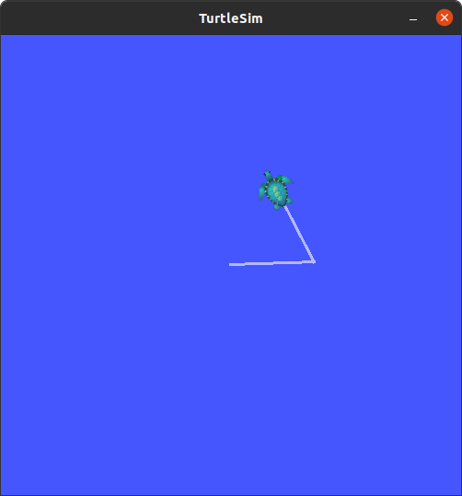
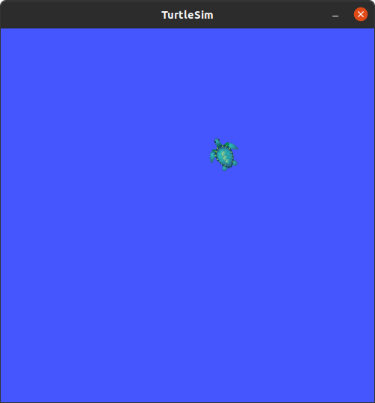
ROS Service – Call
$ rosservice call /clear

Slide 54
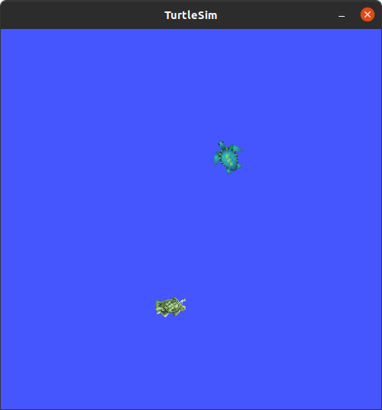
ROS Service – Call
$ rosservice call /spawn "x: 5.0
y: 3.0
theta: 0.0
name: 'WOS_turtle'"
New turtle called “WOS_turtle” spawned at [5, 3]

Slide 55
ROS Parameter Server
Parameters are akin to ‘global variables’ that any topic/services can tap on.
What parameters are available?
$ rosparam list
/rosdistro
/roslaunch/uris/host_robot0_latitude_3400__45073
/rosversion
/run_id
/turtlesim/background_b
/turtlesim/background_g
/turtlesim/background_r

Slide 56
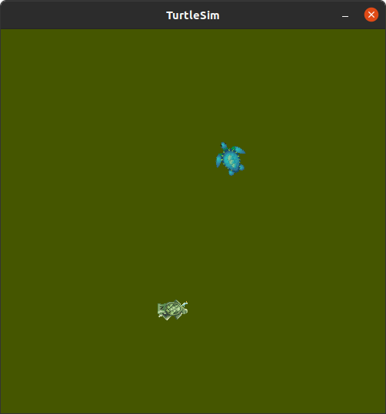
ROS Parameter Server – get / set
$ rosparam get /turtlesim/background_b
255
$ rosparam set /turtlesim/background_b 0
$ rosservice call /clear
Here, we set the ‘blue’ intensity to 0,
Then, call /clear to update the background
Background changed from blue to olive green

Slide 57
ROS Custom Package – Initialization
Let’s make our own ROS package with 2 nodes – ‘talker’ and ‘subscriber’
First, we initialize our package
[~] $ cd catkin_ws/src
[~/catkin_ws/src] $ catkin_create_pkg wos_tutorial std_msgs roscpp
Created file wos_tutorial/package.xml
Created file wos_tutorial/CMakeLists.txt
Created folder wos_tutorial/include/wos_tutorial
Created folder wos_tutorial/src
Successfully created files in /home/robot0/catkin_ws/src/wos_tutorial. Please adjust the values in package.xml.

Slide 58
ROS Custom Package – CMakeLists.txt
Let’s analyse the CMakeLists.txt
cmake_minimum_required(VERSION 3.0.2)
project(wos_tutorial)
find_package(catkin REQUIRED COMPONENTS
roscpp
std_msgs
)
include_directories(
${catkin_INCLUDE_DIRS}
)
Your favourite project name
Add dependencies for project
All catkin packages require catkin
We further define roscpp, std_msgs as COMPONENTS
Note: COMPONENTS is a useful utility that XX_ environment variables as part of catkin_

Slide 59
Package.xml
<?xml version="1.0"?>
<package format="2">
<name>wos_tutorial</name>
<version>0.0.0</version>
<description>The wos_tutorial package</description>
<maintainer email="robot0@todo.todo">robot0</maintainer>
<buildtool_depend>catkin</buildtool_depend>
<build_depend>roscpp</build_depend>
<build_depend>std_msgs</build_depend>
<build_export_depend>roscpp</build_export_depend>
<build_export_depend>std_msgs</build_export_depend>
<exec_depend>roscpp</exec_depend>
<exec_depend>std_msgs</exec_depend>
</package>

Slide 60
Writing the talker node
#include "ros/ros.h"
#include "std_msgs/String.h"
#include <sstream>
int main(int argc, char **argv)
{
ros::init(argc, argv, "talker");
ros::NodeHandle n;
ros::Publisher chatter_pub =
n.advertise<std_msgs::String>("chatter", 1000);
ros::Rate loop_rate(10);
Initialize a node named ‘talker’
Start (and destroys) the node
advertise creates a topic that will await the ‘publish’ command to the topic “chatter”, with a buffer of 1000
loop at 10Hz

Slide 61
Writing the talker node (cont.)
int count = 0;
while (ros::ok())
{
std_msgs::String msg;
std::stringstream ss;
ss << "Hello World of Science!" << count;
msg.data = ss.str();
ROS_INFO("%s", msg.data.c_str());
chatter_pub.publish(msg);
ros::spinOnce();
loop_rate.sleep();
++count;
}
}
Standard ROS string message class. Name variable as msg
Pass in a string into msg
Publish msg to the chatter_pub
Process any callbacks
Sleep at 10Hz

Slide 62
Writing the listener node
#include "ros/ros.h"
#include "std_msgs/String.h"
void chatterCallback(const std_msgs::String::ConstPtr& msg)
{
ROS_INFO("I heard: [%s]", msg->data.c_str());
}
int main(int argc, char **argv)
{
ros::init(argc, argv, "listener");
ros::NodeHandle n;
ros::Subscriber sub =
n.subscribe("chatter", 1000, chatterCallback);
ros::spin();
return 0;
}
subscribe listens to the topic “chatter” and consistently calls a callback function, with a buffer of 1000.
Process any callbacks
Notes:
Callback, in its simplest term, is passing a function as an argument.

Slide 63
ROS Custom Package – CMakeLists.txt
Let’s analyse the CMakeLists.txt
cmake_minimum_required(VERSION 3.0.2)
project(wos_tutorial)
find_package(catkin REQUIRED COMPONENTS
roscpp
std_msgs
)
include_directories(
${catkin_INCLUDE_DIRS}
)
add_executable(talker src/talker.cpp)
target_link_libraries(talker ${catkin_LIBRARIES})
add_executable(listener src/listener.cpp)
target_link_libraries(listener ${catkin_LIBRARIES})
Note: You should also add (any) custom messages and services here!
We add the nodes as executable files here!

Slide 64
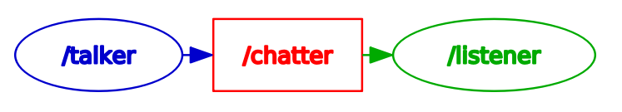
Let’s test it out!
First, catkin_make the package
Talker >> rosrun wos_tutorial talker
[ INFO] [1654968481.794950183]: Hello World of Science!2878
Listener >> rosrun wos_tutorial listener
[ INFO] [1654968481.795636210]: I heard: [Hello World of Science!2878]

Slide 65
ROS Message/Service Creation
These topics are useful, but out-of-scope for now.
For more information, visit
https://wiki.ros.org/msg
https://wiki.ros.org/srv
https://wiki.ros.org/ROS/Tutorials/CreatingMsgAndSrv

Slide 66
ROS Launch
It can get cumbersome opening multiple terminals & running multiple rosrun
roslaunch is a solution! roslaunch automatically calls roscore if required
$ roscd wos_tutorial
$ mkdir launch
$ echo “” >> run_conversation.launch
<launch>
<node pkg="wos_tutorial" name="wos_talker" type="talker" output="screen"/>
<node pkg="wos_tutorial" name="wos_listener" type="listener" output="screen"/>
</launch>

Slide 67
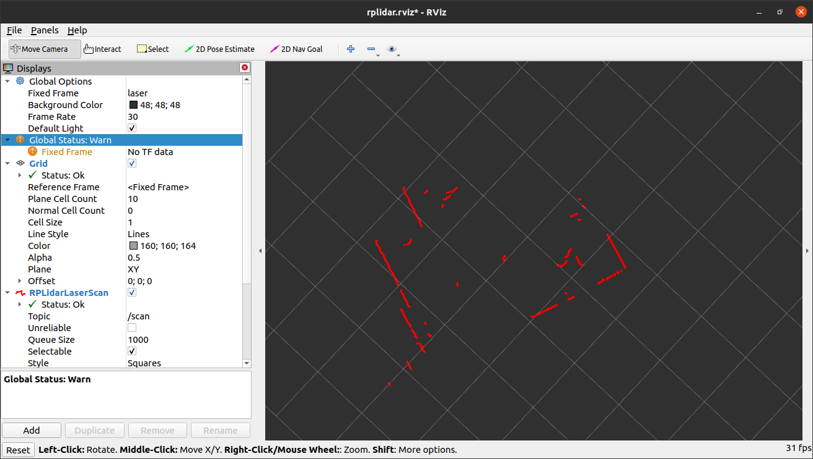
Brief Introduction to Rviz
Red dots point cloud on screen
Add new data to display

Slide 68
What’s next?
Create your own workspace.
Download and build the rplidar package: https://github.com/Slamtec/rplidar_ros
Check that lidar and ROS is working, and you’re able to view telemetry in RViz on laptop
Configure multi-machine ROS (with raspberry pi as main). You should strive to obtain a WIRELESS setup, with the lidar linked to the raspberry pi, and the RViz display on your screen. This reference may be useful: https://wiki.ros.org/ROS/Tutorials/MultipleMachines Hints: a) Learn how to ‘ssh’ into raspberry pi b) Make sure that your 2 machines are communicating by ping-ing and/or passing a simple talker/listener ROS message. c) Display rplidar telemetry using RViz
Practise, practise, practise and have fun! :)

